Slide 1

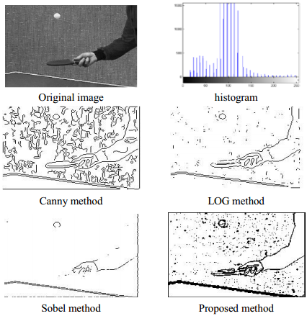
A New Algorithm Based Entropic Threshold for Edge Detection in Images
קורס תורת המידע Information Theory)) ,מספר קורס 55024 , מרצה: פרופסור יוסף בן-עזרא
מגישים: טימור ליידרמן ואסף קסלסי
Mohamed A. El-Sayed CS dept, Faculty of Computers and Information Systems , Taif University, 21974 Taif, KSA Mathematics department, Faculty of Science, Fayoum University, 63514 Fayoum, Egypt

Slide 2
Abstract Edge detection is one of the most critical tasks in automatic image analysis. There exists no universal edge detection method which works well under all conditions. This paper shows the new approach based on the one of the most efficient techniques for edge detection, which is entropy-based thresholding. The main advantages of the proposed method are its robustness and its flexibility.

Slide 3
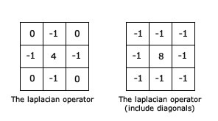
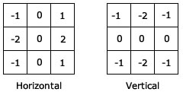
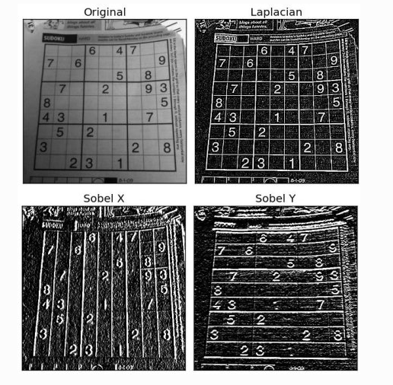
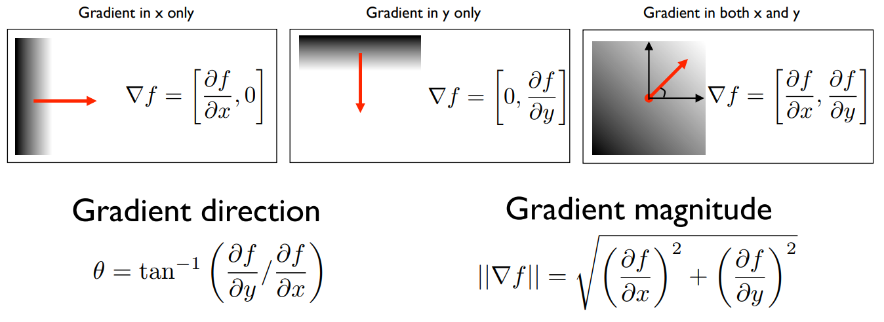
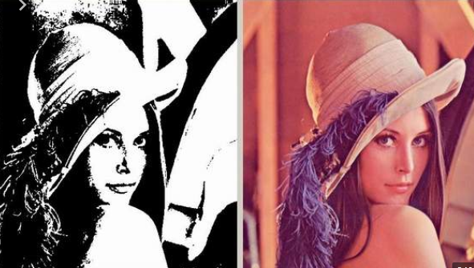
Edges are mostly detected using either the first derivatives, called gradient or the second derivatives, called Laplacien
Kernels used in the Sobel edge detection

Slide 4
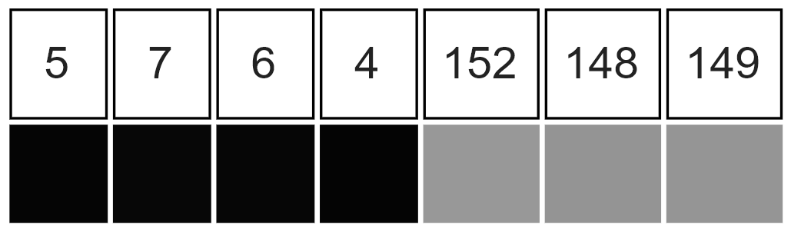
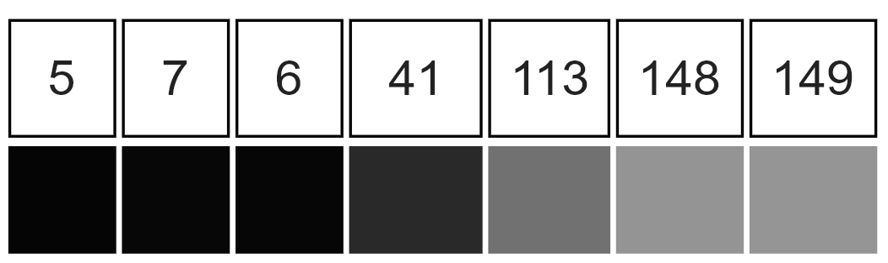
To illustrate why edge detection is not a trivial task, consider the problem of detecting edges in the following one-dimensional signal. Here, we may intuitively say that there should be an edge between the 4th and 5th pixels. If the intensity difference were smaller between the 4th and the 5th pixels and if the intensity differences between the adjacent neighboring pixels were higher, it would not be as easy to say that there should be an edge in the corresponding region. Moreover, one could argue that this case is one in which there are several edges.

Slide 5
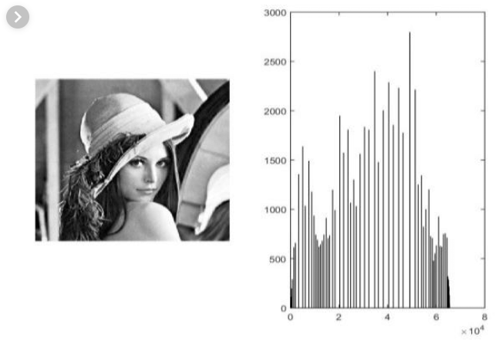
histogram An image histogram is a type of histogram that acts as a graphical representation of the tonal distribution in a digital image. It plots the number of pixels for each tonal value. By looking at the histogram for a specific image a viewer will be able to judge the entire tonal distribution at a glance

Slide 6
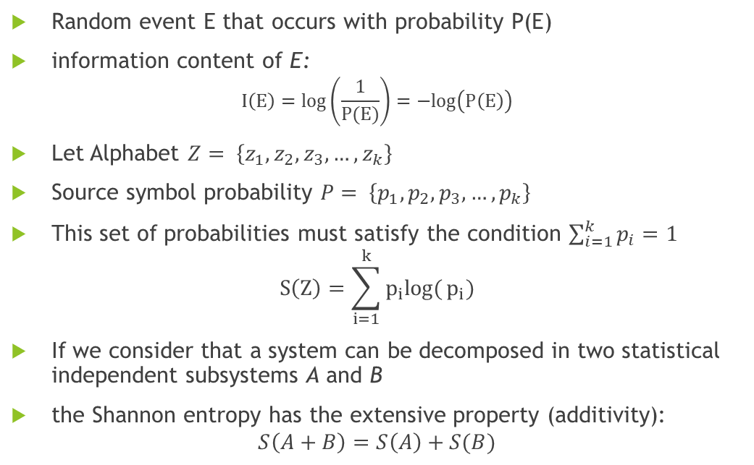
Image thresholding based on Shannon and Tsallis entropies
Random event E that occurs with probability P(E)
information content of E:
$$I\left(E\right)=log\left(\frac{1}{P(E)}\right)=−log\left(P\left(E\right)\right)$$
Let Alphabet $Z= \left\{z_{1},z_{2},z_{3},…,z_{k}\right\}$
Source symbol probability $P= \left\{p_{1},p_{2},p_{3},…,p_{k}\right\}$
This set of probabilities must satisfy the condition $\sum_{i=1}^{k}{p_{i}=1}$
$$S\left(Z\right)=\sum_{i=1}^{k}{p_{i}log(}p_{i})$$
If we consider that a system can be decomposed in two statistical independent subsystems A and B
the Shannon entropy has the extensive property (additivity):
$$S\left(A+B\right)=S\left(A\right)+S(B)$$

Slide 7
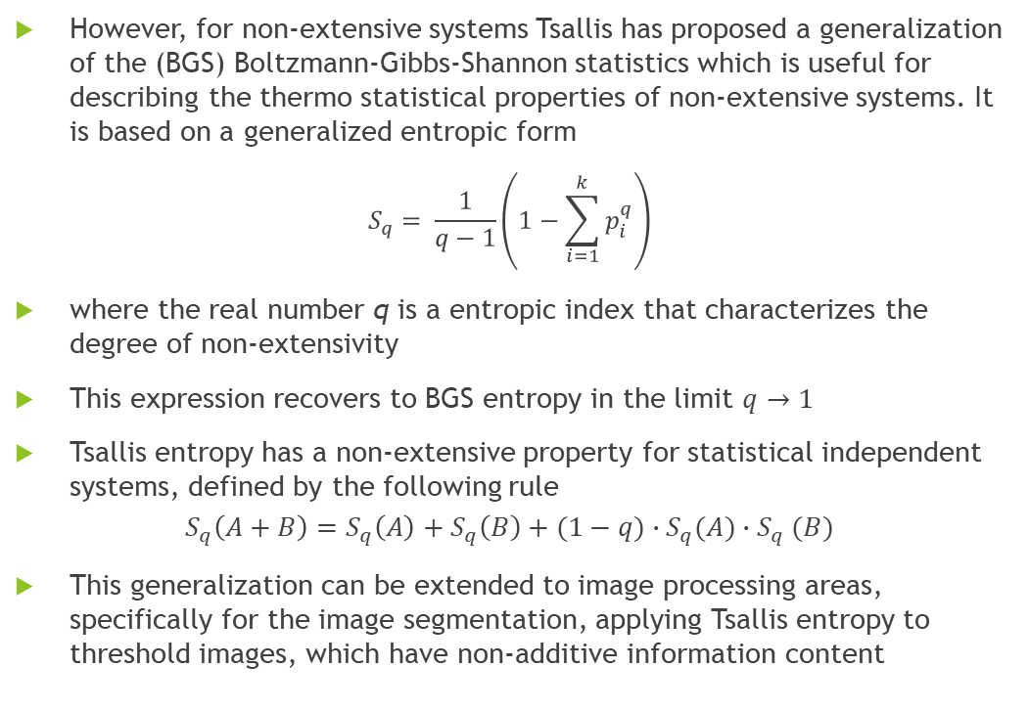
However, for non-extensive systems Tsallis has proposed a generalization of the (BGS) Boltzmann-Gibbs-Shannon statistics which is useful for describing the thermo statistical properties of non-extensive systems. It is based on a generalized entropic form
$$S_{q}= \frac{1}{q−1}\left(1−\sum_{i=1}^{k}{p_{i}^{q}}\right)$$
where the real number q is a entropic index that characterizes the degree of non-extensivity
This expression recovers to BGS entropy in the limit $q→1$
Tsallis entropy has a non-extensive property for statistical independent systems, defined by the following rule
$$S_{q}\left(A+B\right)=S_{q}\left(A\right)+S_{q}\left(B\right)+(1−q)∙S_{q}(A){∙S}_{q}(B)$$
This generalization can be extended to image processing areas, specifically for the image segmentation, applying Tsallis entropy to threshold images, which have non-additive information content

Slide 8
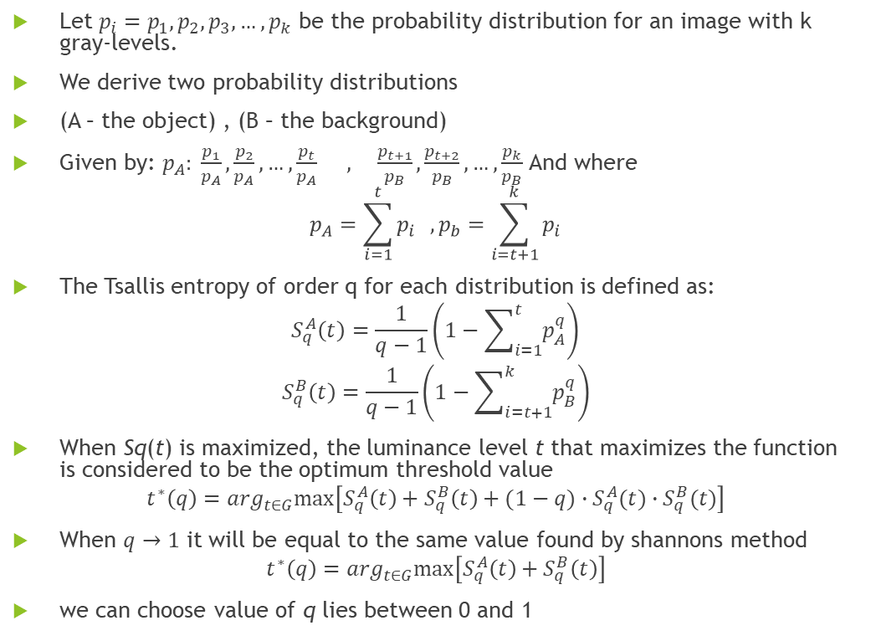
Let $p_{i}=p_{1},p_{2},p_{3},…,p_{k}$ be the probability distribution for an image with k gray-levels.
We derive two probability distributions
(A – the object) , (B – the background)
Given by: $p_{A}: \frac{p_{1}}{p_{A}},\frac{p_{2}}{p_{A}},…,\frac{p_{t}}{p_{A}} , \frac{p_{t+1}}{p_{B}},\frac{p_{t+2}}{p_{B}},…,\frac{p_{k}}{p_{B}}$ And where
$$p_{A}=\sum_{i=1}^{t}{p_{i}} , p_{b}=\sum_{i=t+1}^{k}{p_{i}}$$
The Tsallis entropy of order q for each distribution is defined as:
$$S_{q}^{A}\left(t\right)=\frac{1}{q−1}\left(1−\sum_{i=1}^{t}{p_{A}^{q}}\right)$$
$$S_{q}^{B}\left(t\right)=\frac{1}{q−1}\left(1−\sum_{i=t+1}^{k}{p_{B}^{q}}\right)$$
When Sq(t) is maximized, the luminance level t that maximizes the function is considered to be the optimum threshold value
$$t^{∗}\left(q\right)=\arg_{t∈G}max⁡\left[S_{q}^{A}\left(t\right)+S_{q}^{B}\left(t\right)+(1−q)∙S_{q}^{A}(t)∙S_{q}^{B}(t)\right]$$
When $q→1$ it will be equal to the same value found by shannons method
$$t^{∗}\left(q\right)=\arg_{t∈G}max⁡\left[S_{q}^{A}\left(t\right)+S_{q}^{B}\left(t\right)\right]$$
we can choose value of q lies between 0 and 1

Slide 9
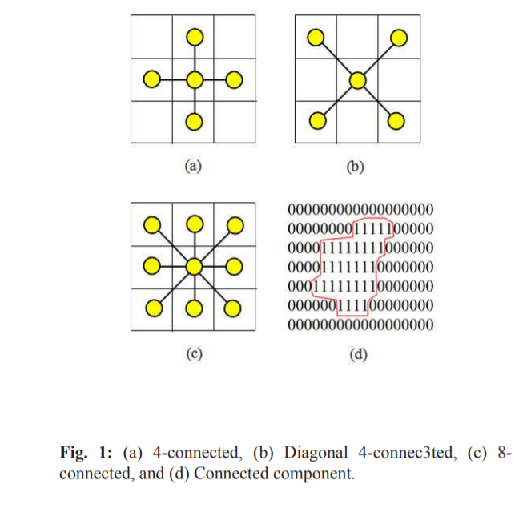
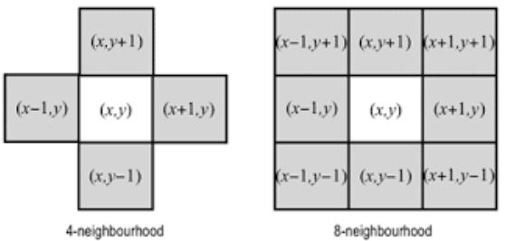
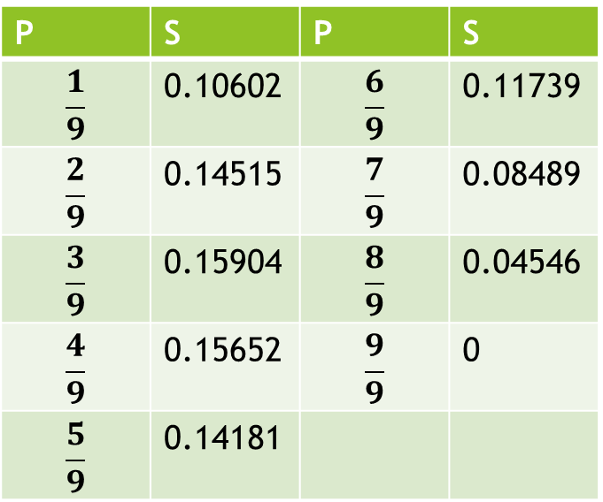

$$S=−P∗Log(P)$$
P | S | P | S
$$\frac{1}{9}$$ | 0.10602 | $$\frac{6}{9}$$ | 0.11739
$$\frac{2}{9}$$ | 0.14515 | $$\frac{7}{9}$$ | 0.08489
$$\frac{3}{9}$$ | 0.15904 | $$\frac{8}{9}$$ | 0.04546
$$\frac{4}{9}$$ | 0.15652 | $$\frac{9}{9}$$ | 0
$$\frac{5}{9}$$ | 0.14181

Slide 10
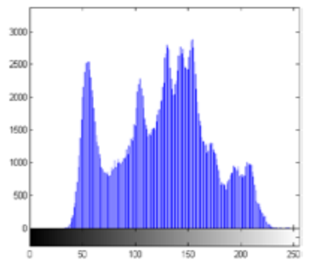
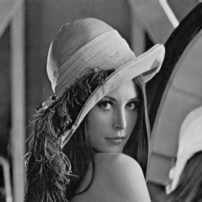
Algo Flow

Slide 11
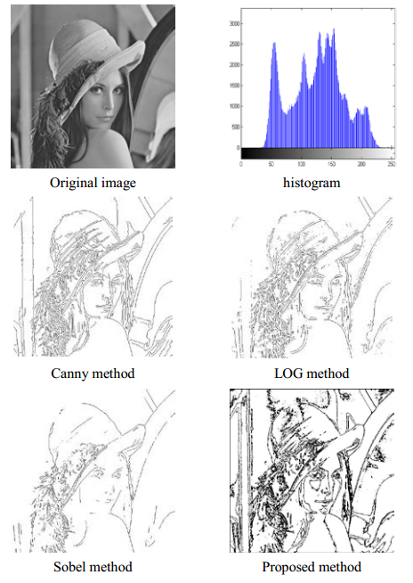

Slide 12
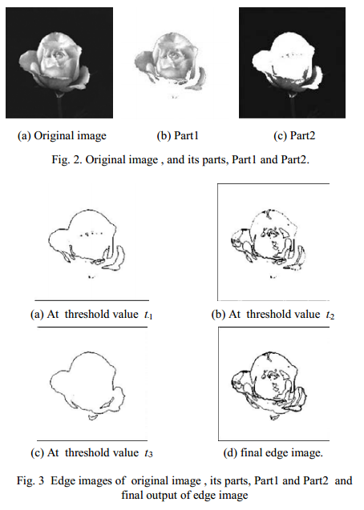

Slide 13
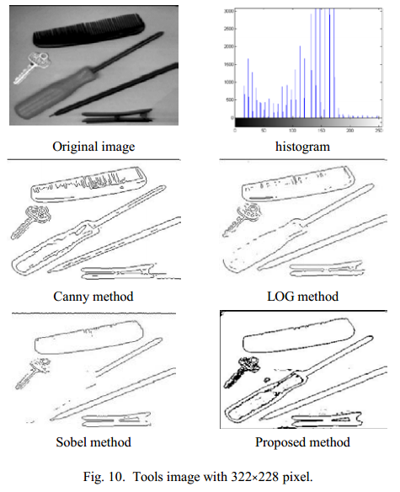

Slide 14
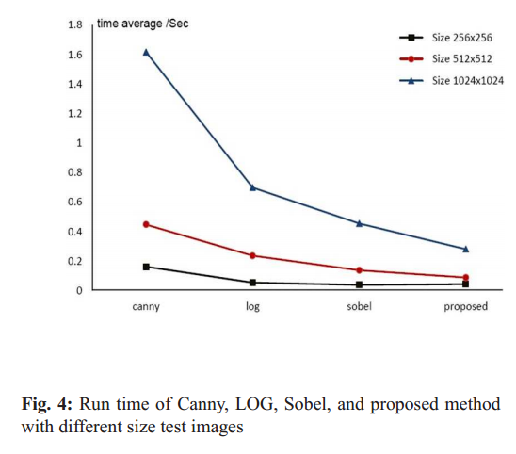

Slide 15
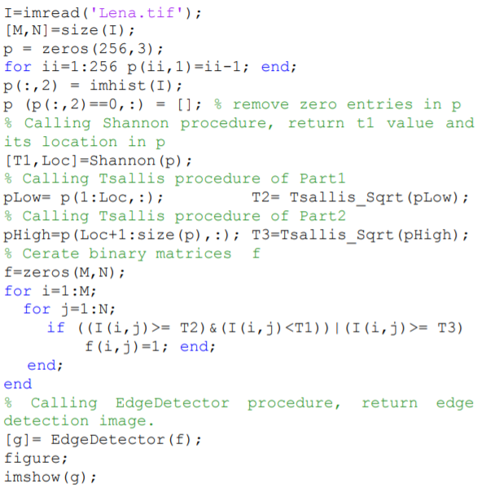
MainProgram.m file

Slide 16
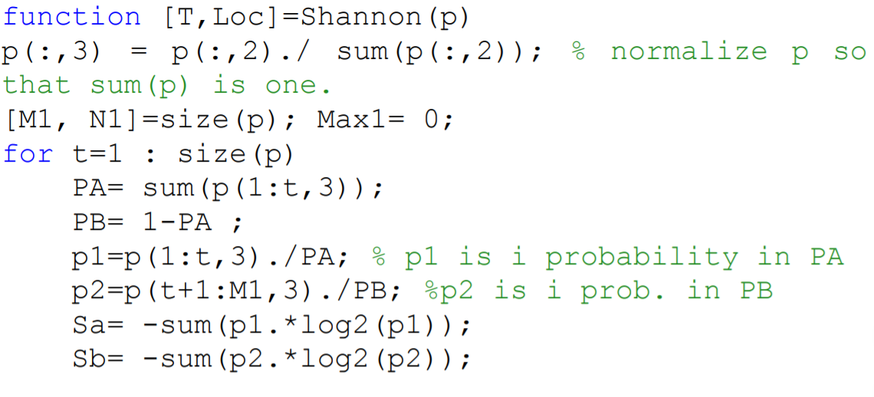
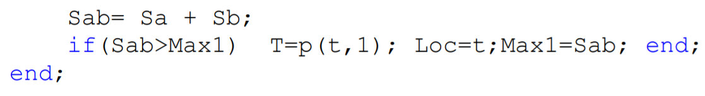
Shannon.m file

Slide 17
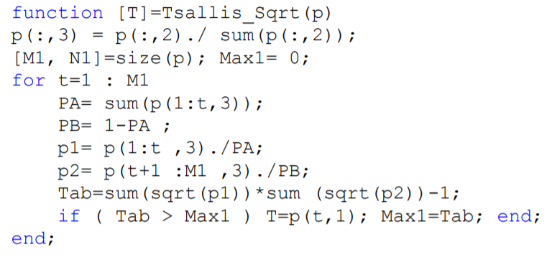
Tsallis_Sqrt.m file

Slide 18
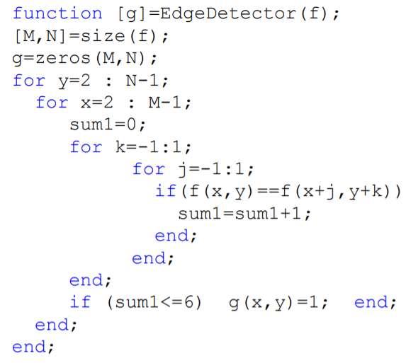
EdgeDetector.m file

Slide 19
Results
Experimental results demonstrate that the proposed method achieves better result than some classic methods and the quality of the edge detector of the output images is robust and decrease the computation time

Slide 20
Thank you

